Slide 1
Understanding Pointers

Slide 2
Outline
Understanding Pointers
Suggested reading
  Chap 3.10

Slide 3
Pointers
Every pointer has a type
  If the object has type T
    A pointer to this object has type T *
  Special void * type
    Represents a generic pointer
  malloc returns a generic pointer
Every pointer has a value

Slide 4
Pointers
Pointers are created with the & operator
  Applied to lvalue expression
    Lvalue expression can appear on the left side of assignment
Pointers are dereferenced with the operator *
  The result is a value having the type associated with the pointer
Arrays and pointers are closed related
  The name of array can be viewed as a pointer constant
  ip[0] is equivalent to *ip

Slide 5
Pointer Arithmetic
Addition and subtraction
  p+i , p-i (result is a pointer)
  p-q (result is a int)
Referencing & dereferencing
  *p, &E
Subscription
  A[i], *(A+i)

Slide 6
Example
static int daytab[2][13] = {
{0, 31, 28, 31, 30, 31, 30, 31, 31, 30, 31, 30, 31},
{0, 31, 29, 31, 30, 31, 30, 31, 31, 30, 31, 30, 31}
}
/* day_of_year: set day of year from month & day */
int day_of_year(int year, int month, int day)
{
int i, leap;
leap = (year%4 == 0 && year%100 != 0
|| year%400 ==0);
for (i = 1; i < month; i++)
day += daytab[leap][i];
return day;
}

Slide 7
Example
/* month_day: set month, day from day of year */
int month_day(int year, int yearday,
int *pmonth, int *pday)
{
int i, leap;
leap = (year%4 == 0 && year%100 != 0
|| year%400 ==0);
for (i = 1; yearday > daytab[leap][i] ; i++)
yearday -= daytab[leap][i];
*pmonth = i;
*pday = yearday;
}

Slide 8
Pointer Array
/* month_name: return name of n-th month */
char *month_name(int n)
{
static char *name[] = {
“Illegal month”,
“January”, “February”, “March”,
“April”, “May”, “June”,
“July”, “August”, “September”,
“October”, “November”, “December”
};
return (n < 1 || n > 12) ? name[0] : name[n];
}

Slide 9
Pointer Array
Illegal month\0
January\0
February\0
March\0
April\0
May\0
June\0
July\0
August\0
September\0
October\0
November\0
December\0

Slide 10
Command-line Arguments
argv:
$echo hello, world
$hello, world
#include <stdio.h>
/* echo command-line arguments */
int main(int argc, char *argv[])
{
int i ;
for (i = 1; i < argc ; i++)
printf(“%s%s”, argv[i],
(i < argc-1) ? “ ” : “”);
printf(“\n”) ;
return 0;
}
NULL
echo\0
Hello,\0
World\0

Slide 11
Command-line Arguments
#include <stdio.h>
/* echo command-line arguments ; 2nd version*/
int main(int argc, char *argv[])
{
while (--argc > 0)
printf(“%s%s”, ++argv, (argc > 1) ? “ ” : “”);
printf(“\n”);
return 0;
}
or
printf((argc > 1) ? “%s ” : “%s”, ++argv);

Slide 12
Pointer to Function
#include <stdlib.h>
/* numcmp: compare s1 and s2 numerically */
int numcmp(char *s1, char *s2)
{
double v1, v2;
v1 = atof(s1);
v2 = atof(s2);
if (v1 < v2) return -1;
else if ( v1 > v2 ) return 1;
else return 0;
}

Slide 13
Pointer to Function
#include <stdio.h>
#include <string.h>
{
...
int numeric = 0, (*cmp)(void *, void *);
char *s1, *s2;
...
if (...) numeric = 1 ;
...
cmp = (int (*)(void *, void *))
(numeric ? numcmp : strcmp);
(*cmp)(s1, s2);
...
}

Slide 14
Pointers can point to functions
void (*f)(int *)
f is a pointer to function
The function taken int * as argument
The return type of the function is void
Assignment makes f point to func
  f = func
Notice the precedence of the operators
  void *f(int *) declares f is a function
    (void *) f(int *)

Slide 15
Pointer Declaration
char **argv ;
int (*daytab)[13]
int (*comp)()
char (*(*x())[])()
  Function returning pointer to array[ ] of pointer to function returning char
char (*(*x[3])())[5]
  Array[3] of pointer to function returning pointer to array[5] of char

Slide 16
C operators
Operators Associativity
() [] -> . ++ -- left to right
! ~ ++ -- + - * & (type) sizeof right to left
* / % left to right
+ - left to right
<< >> left to right
< <= > >= left to right
== != left to right
& left to right
^ left to right
| left to right
&& left to right
|| left to right
?: right to left
= += -= *= /= %= &= ^= != <<= >>= right to left
, left to right
Note: Unary +, -, and * have higher precedence than binary forms

Slide 17
Parameter Passing
Call by value
  f(xp)
Call by reference
  f(&xp)

Slide 18
Buffer Overflow

Slide 19
Out-of-Bounds Memory References
1 /* Implementation of library function gets() */
2 char *gets(char *s)
3 {
4 int c;
5 char *dest = s;
6
7 while ((c = getchar()) != ’\n’ && c != EOF)
8 *dest++ = c; /* No bounds checking */
9 if (c == EOF && dest ==s)
10 return NULL; /* No characters read */
11 *dest++ = ’\0’; /* Terminate String */
12 return s;
13 }

Slide 20
Out-of-Bounds Memory References
14 /* Read input line and write it back */
15 void echo()
16 {
17 char buf[8]; /* Way too small ! */
18 gets(buf);
19 puts(buf);
20 }

Slide 21
Out-of-Bounds Memory References
Return address
[7] | [6] | [5] | [4]
[3] | [2] | [1] | [0]
Stack frame
for caller
Stack frame
for echo
buf

Slide 22
Out-of-Bounds Memory References
Return address
[11] | [10] | [9] | [8]
[7] | [6] | [5] | [4]
[3] | [2] | [1] | [0]
Stack frame
for caller
Stack frame
for echo
buf

Slide 23
Out-of-Bounds Memory References
Return address
[15] | 1[4] | [13] | [12]
[11] | [10] | [9] | [8]
[7] | [6] | [5] | [4]
[3] | [2] | [1] | [0]
Stack frame
for caller
Stack frame
for echo
buf

Slide 24
Out-of-Bounds Memory References
[23] | [22] | [21] | [20]
[19] | [18] | [17] | [16]
[15] | 1[4] | [13] | [12]
[11] | [10] | [9] | [8]
[7] | [6] | [5] | [4]
[3] | [2] | [1] | [0]
Stack frame
for caller
Stack frame
for echo
buf

Slide 25
Malicious Use of Buffer Overflow
Stack
after call to gets()
void foo(){
bar();
...
}
return
address
A
foo stack frame
void bar() {
char buf[64];
gets(buf);
...
}
B
data
written
by
gets()
pad
exploit
code
bar stack frame
B

Slide 26
The Famous Internet Worm of November 1988
To gain access to many of the computers across the Internet
  4 different ways
  One was a buffer overflow attack on the fingerd
Hundreds of machines were effectively paralyzed
The author of the worm was caught and prosecuted. He was sentenced to
  3 years probation
  400 hours of community service
  and a $10,500 fine

Slide 27
The Famous Internet Worm of November 1988
Steps
  invoked finger with an appropriate string
  Made a process at a remote site have a buffer overflow
  executed code that gave the worm access to the remote system
  The worm replicated itself and consumed virtually all of the machine’s computing resources

Slide 28

Morris Worm
Robert Tappan Morris
  born November 8, 1965
  a professor at MIT
  He is the son of Robert Morris
    the former chief scientist at the National Computer Security Center
      a division of the National Security Agency (NSA)

Slide 29
Stack Randomization
1 int main() {
2 long local;
3 printf("local at %p\n", &local);
4 return 0;
5 }
Running the code 10,000 times on a Linux (maybe 2.6.16) machine in 32-bit mode
the addresses ranged from
  0xff7fc59c to 0xffffd09c
  A range of around 2²³

Slide 30
Stack Randomization
Running in 64-bit mode on the newer machine
The addresses ranged from
  0x7fff0001b698 to 0x7ffffffaa4a8
  A range of nearly 2³²
Address-space layout randomization (ASLR)
  each time a program is run
  different parts of the program are loaded into different regions of memory
    code, data, heap data, library code, stack

Slide 31
Stack Randomization
Nop sled
  a program “slides” through a long sequence of “nop”
Nop
  no operation instruction
Include a “nop sled” before the actual exploit code
  If insert 256-byte nop sled
  Need to guess 2¹⁵ starting addresses (no too much) for 32-bit machine
  Still have too many 2²⁴ for 64-bit machine

Slide 32
Stack Corruption Detection
Return address
Canary
[7] | [6] | [5] | [4] | [3] | [2] | [1] | [0]
Stack frame
for caller
%rsp+24
Stack frame
for echo
buf=%rsp

Slide 33
Stack Corruption Detection
1 echo:
2 subq $24, %rsp # Allocate 24 bytes on stack
3 movq %fs:40, %rax # Retrieve canary
4 movq %rax, 8(%rsp) # Store on stack
5 xorl %eax, %eax # Zero out register
6 movq %rsp, %rdi # Compute buf as %rsp
7 call gets # Call gets
8 movq %rsp, %rdi # Compute buf as %rsp
9 call puts # Call puts
10 movq 8(%rsp), %rax # Retrieve canary
11 xorq %fs:40, %rax # Compare to stored value
12 je .L9 # If =, goto ok
13 call __stack_chk_fail # Stack corrupted!
14 .L9 # ok:
15 addq $24, %rsp # Deallocate stack space
16 ret

Slide 34
Stack Corruption Detection
%fs:40
  Segmented addressing which appeared in 80286 and seldom used today
  It is marked as read only

Slide 35
Limiting Executable Code Regions
Page
  4k bytes
  As a protected unit by OS
  Should be marked as “readable”, “writable” and “executable”
    3 bits are required
Originally Intel merged the “readable” and “executable” into one
  The exploit code in the stack can be executed
AMD introduced “NX” in X86-64
  Now there 3 bits
  How about “JIT”?

Slide 36
Code Reuse Attack
Return-oriented Programming
  Find code gadgets in existed code base (e.g. libc)
  Push address of gadgets on the stack
  Leverage ‘ret’ to connect code gadgets
  No code injection
Solutions
  Return-less kernels
  Heuristic means
Address C
Address B
Address A
return addr
A
0101011010
B
0101011010
C
0101011010

Slide 37
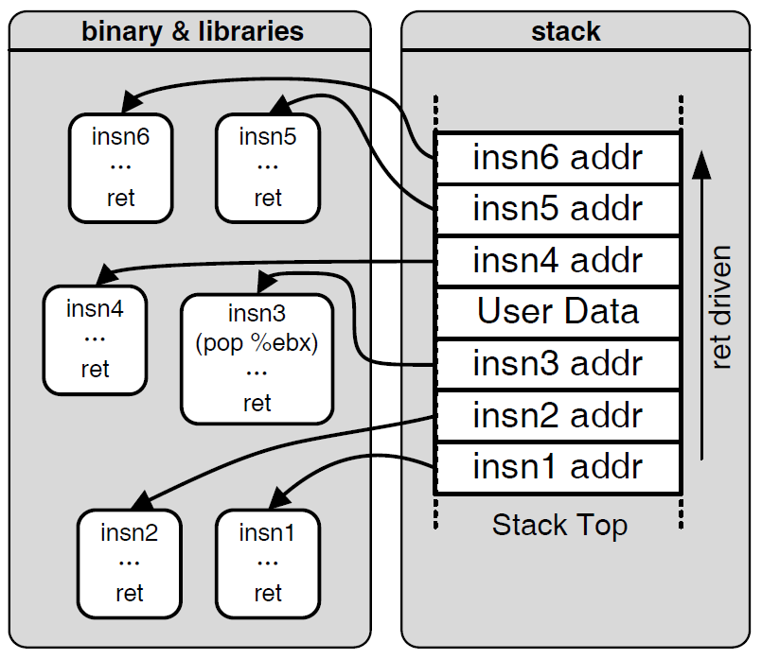

Motivation: Code Reuse Attack

Slide 38
Supporting Variable-Size Stack Frames
(a) C code
long vframe(long n, long idx, long *q) {
long i;
long *p[n];
p[0] = &i;
for (i = 1; i < n; i++)
p[i] = q;
return *p[idx];
}

Slide 39
Supporting Variable-Size Stack Frames
(b) Portions of generated assembly code
long vframe(long n, long idx, long *q)
n in %rdi, idx in %rsi, q in %rdx
Only portions of code shown
1 vframe:
2 pushq %rbp Save old %rbp
3 movq %rsp, %rbp Set frame pointer

Slide 40
Supporting Variable-Size Stack Frames
4 subq $16, %rsp Allocate space for i (%rsp = s1)
5 leaq 22(,%rdi,8), %rax
6 andq $-16, %rax
7 subq %rax, %rsp Allocate space for array p (%rsp = s2)
8 leaq 7(%rsp), %rax
9 shrq $3, %rax
10 leaq 0(,%rax,8), %r8 Set %r8 to &p[0]
11 movq %r8, %rcx Set %rcx to &p[0] (%rcx = p)
. . .
Code for initialization loop
i in %rax and on stack, n in %rdi, p in %rcx, q in %rdx

Slide 41
Supporting Variable-Size Stack Frames
12 .L3: loop:
13 movq %rdx, (%rcx,%rax,8) Set p[i] to q
14 addq $1, %rax Increment i
15 movq %rax, -8(%rbp) Store on stack
16 .L2:
17 movq -8(%rbp), %rax Retrieve i from stack
18 cmpq %rdi, %rax Compare i:n
19 jl .L3 If <, goto loop
. . .
Code for function exit
20 leave Restore %rbp and %rsp
21 ret Return

Slide 42
Supporting Variable-Size Stack Frames
Using %rbp as a frame pointer for the top of the stack frame
At the beginning of vframe
  pushq %rbp
  movq %rsp, %rbp
At the end of vframe
  movq %rbp, %rsp
  popq %rbp

Slide 43
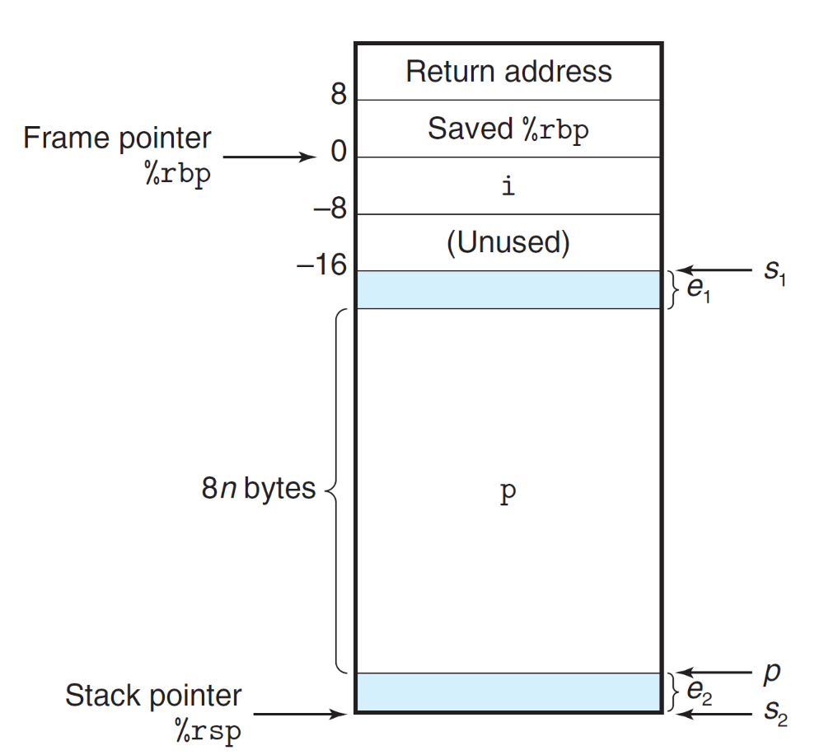
Supporting Variable-Size Stack Frames

Slide 44
Supporting Variable-Size Stack Frames
The leaq instruction of line 5
  computes the value 8n + 22
  which is then rounded down to the nearest multiple of 16
  by the andq instruction of line 6.
The resulting value will be
  8n + 8 when n is odd
  8n + 16 when n is even
This value is subtracted from s1 to give s2

Slide 45
Supporting Variable-Size Stack Frames
The three instructions in lines 8-10 round s2 up to the nearest multiple of 8.
They make use of the combination of biasing and shifting
  (S2+7)/8
n | s1 | s2 | p | e1 | e2
5 | 2065 | 2017 | 2024 | 1 | 7
6 | 2064 | 2000 | 2000 | 16 | 0

Slide 46
Supporting Variable-Size Stack Frames
s2 is computed in a way that preserves whatever offset s1 has with the nearest multiple of 16
p will be aligned on a multiple of 8
  as is recommended for an array of 8-byte elements

